Slide 1

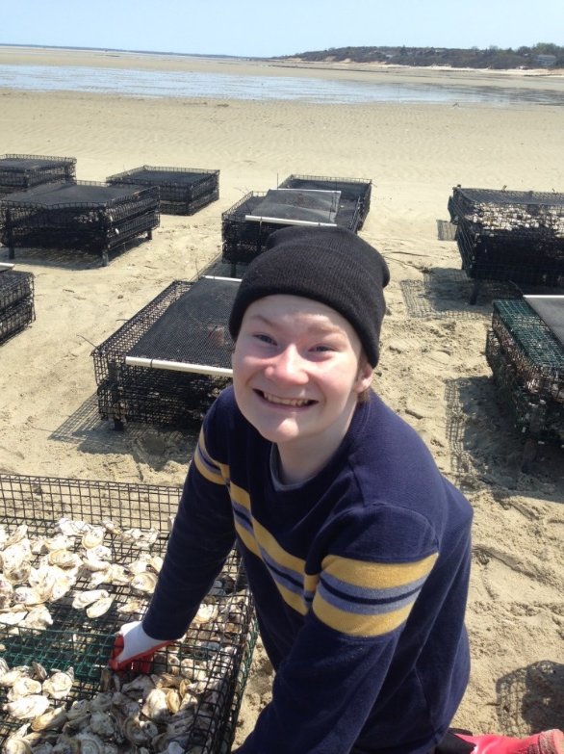
Brewster, Massachusetts
Surviving Staying at Home Without Wanting to Run Away
Patrice Carroll, LCSW
PCarroll@LathamCenters.org
Director of PWS Services
Latham Centers, Inc.
Providing Residential, Vocational, Educational and Clinical Programs for Students and Adults with Prader-Willi Syndrome and Complex Special Needs.

Slide 2
Thriving in the New Normal
Create a routine that works
Be kind to yourself
Actively look for the positives
Acknowledge sensory issues and make a calming space
Remember that your kids are trying to do their best- move the things out of the way that make it hard to have a good day
Don’t force your agenda, it’s ok if the plan for the day has to change/routines are only helpful if they’re helpful

Slide 3


Educating at Home
Do not try to be teacher of the year
Use what they already like
Communicate your ideas with their teachers
It’s ok to stick to review
Set your own expectations, not someone else’s
Learning will happen naturally, be flexible

Slide 4
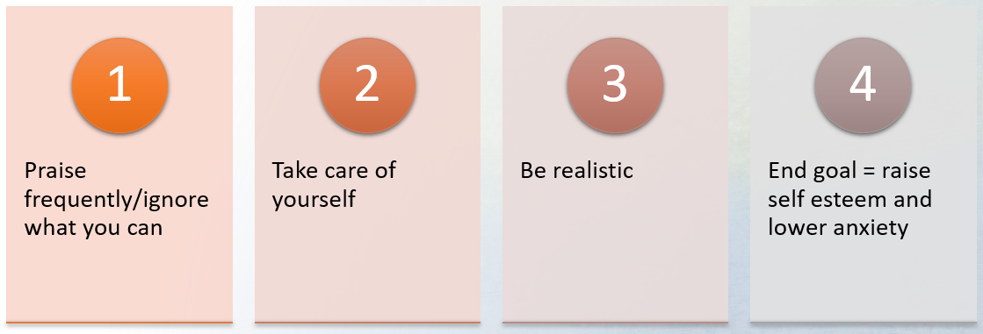
Emotional health

Slide 5

When things don’t go as planned
Do not compare yourself to others
It’s ok to give up for the day. You can try again tomorrow
Have a safe space for the rest of the family
If it’s not working, stop doing it even if it works for everyone else

Slide 6
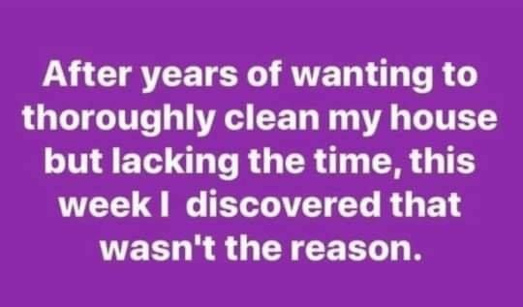
Questions

