Slide 1
Repetitive Behaviors in PWS
What to do and when to do it
Elizabeth Roof
Vanderbilt University

Slide 2
Chicken or the egg?
Repetitive behaviors are often related to anxiety
People who are anxious are highly intolerant of uncertainty
People may experience high level of discomfort in ambiguous or unclear situations
This can lead to repetitive behaviors which can lead to temporary relief, but can also increase to get the same feeling-compulsion
Compulsions like scratching a mosquito bite, can relieve the feeling, but then the need to keep doing it kicks in and then it is hard to stop.

Slide 3
Anxiety in PWS
Could look like worry
Constant need for reassurance
Need to control situations/people
Initial push back in new situations
Questions about schedules/expectations
Transitions are very hard

Slide 4
Self-soothing versus repetitive behavior
Distinguish the two- self soothing (tearing paper) leads to more calm while repetitive behavior when related to anxiety means that the behavior itself can be hard to stop- like questions.
Build self soothing into the day
Determine a schedule (your child can help make it) and then follow it- build in breaks!! Or it is gonna break you!!
Build in some chance- (spinner) so your child can start to tolerate uncertainty.
Build in movement/deep breathing breaks- they should be fun!!

Slide 5
Some strategies
Limit questions to 3
Allow them to teach you a skill/subject
Use daily activities to teach new skills
Allow them to be in charge of some activities
Use their sense of control to help others-brainstorm-but not too ambitious
Talk about what the control and what they don’t-be concrete

Slide 6
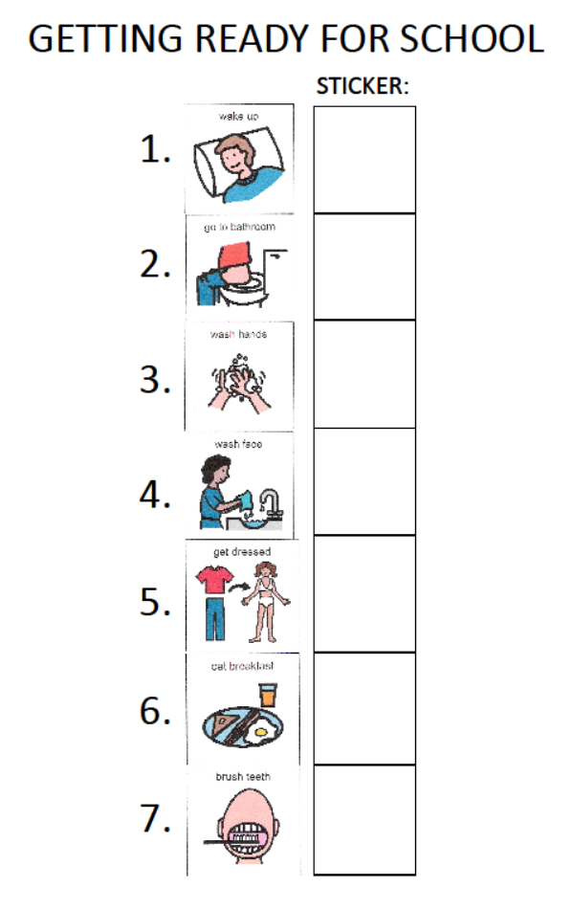
Visual schedule
Helps to move forward
Gives steps in order
Concrete reminder
Sense of accomplishment
Know when its done
Refer to schedule

Slide 7
Motivation
They have to feel like they are in control-let them have some
Compete against each other- pedometer- problems
Use timers and other means to keep it going
You have to make it fun
You have to be accountable-say what you mean and mean what you say!
It may ebb and flow and that is natural- don’t fight it!

Slide 8
Your job is to find a way to say yes

Slide 9
A YES man is not a bad thing thing
BUT a maybe man is the worst

Slide 10
Personal characteristics that fit well with PWS
Easy going and patient
Flexible and creative
Emotionally secure and stable
Problem Solver
Calm and confident
Able to consistently reward behavior

