Slide 1

Intranasal Oxytocin for Hyperphagia and ASD Features in Prader Willi Syndrome
Eric Hollander, M.D.
Director - Autism, Obsessive-Compulsive and Orphan Disorders Spectrum Program, and Clinical Professor of Psychiatry and Behavioral Sciences at
Albert Einstein College of Medicine and
Montefiore Medical Center
Spectrum Neuroscience and Treatment Institute

Slide 2
Montefiore-Einstein Study Team
Casara Jean Ferretti MS
Rachel Noone MD
Bonnie P. Taylor PhD
Ellen Doernberg BA
Jessica Simberland MD

Slide 3
Disclosures
Foundation for Prader Willi Research
Orphan Products Division– FDA
  (Autism, BDD, PWS, TSC)
Simons Foundation (TSO, Temperature)
Roche (V1a), Coronado Biosciences (TSO)
NIMH, NINDS, NIDA
NARSAD Distinguished Investigator award (OT)
Neuropharm, Forest, Sunovion,
IP - oxytocin and memantine in autism

Slide 4
Autism Spectrum Disorder (ASD)
Neurodevelopmental disorder – early onset
2 core symptom domains
  social-communication
  repetitive behaviors
Notes:
4

Slide 5
Experimental Therapeutics –ASD
Oxytocin (and vasopressin 1a antagonists)
  Social communication domain, binge
Immune-Inflammatory -TSO (cytokines)
  Repetitive behavior domain

Slide 6
Oxytocin personalized treatment for homogeneous disorders
Prader-Willi Syndrome
  15q11-13 paternal imprinting deletion
  Developmental neuropathology Oxytocin neurons (PVN to Post Pit to NA)
  Compulsive eating
  Intranasal OT for Compulsive Eating in PWS with Comorbid ASD
Tuberous Sclerosis – mTOR-opathy
  Tubers, cell cycle disruption
  Rapamaycin is toxic
  Intranasal Oxytocin for TSC with Co-morbid ASD

Slide 7
Prader-Willi Syndrome (PWS)
Rare neurodevelopmental disease (1:15,000)
Lack of expression of paternally derived imprinted material on chromosome 15q11-q13.
Characteristics:
  Mild to moderate intellectual disability
  Severe hypotonia at birth
  Hyperphagia and risk of obesity
  Repetitive and compulsive behaviors
  Skin-picking
  Tantrums
  Social Cognition Deficits
Hyperphagia develops after age 2

Slide 8
Prader-Willi Syndrome
(PWS): Relationship to ASD
19% -25% have co-morbid ASD features
  38% with ASD - maternal uniparental disomy (mUPD) of chromosome 15:
    No paternal input
    Overexpression of maternally-derived UBe3A
    Responsible for targeting proteins for degradation
  Most commonly observed autosomal abnormality in ASD (1-3% of cases)

Slide 9
Prader-Willi Syndrome
(PWS): Mechanism
25-30% patients with PWS have mUPD of chromosome 15
  No paternal input and twice the amount of maternal genetic information
70% of PWS cases paternal deletion mutations of imprinted material is causal and about 2% are caused by imprinting errors of the paternally derived genetics material resulting in silencing of paternal genes
Overexpression of maternally-derived UBe3A
  Responsible for targeting proteins for degradation
Loss of antisense transcripts from paternal chromosome, usually represses UBe3A, results in further upregulation of expression

Slide 10
Prader-Willi Syndrome
(PWS): Oxytocin
Decreased peripheral oxytocin
  decreased number OXT neurons in PVN of hypothalamus, smaller PVN volume
Dysregulated oxytocin signaling - obesity
  Mice haploinsufficiency SIM1 - hyperphagic obesity, reduced OXT and MC4 receptors
  OXT decreases food intake and weight loss

Slide 11
Prior Work with OT in PWS
Single dose OT vs placebo– adult PWS
  Less disruptive behavior, increased trust
  decreased hunger, decreased food intake
  safety
Chronic high dose in child/adults PWS
  increased temper tantrums on higher dose
  Use lower dose (16 iu BID)

Slide 12


Model for how serotonin and PI3K signaling pathways interact via SLca4 and Pten to influence brain size, sociability, PPI, perseverative behaviors (Page et al, 10.1073/pnas.0804428106)

Slide 13
Social deficits in autism
Empathy (mind-blindness)
Eye gaze
Nonverbal communication
Reciprocal interactions

Slide 14
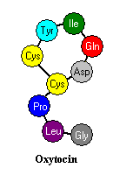
Oxytocin
9 aminoacid neuropeptide
Synthesized in PVN and SON
Peripheral release - delivery and lactation
Central release - social cognition (recognition and memory), trust
OXTR – PIK coupled
Peripheral to central OT feed-forward system
(Vasopressin –V1a-R) – reciprocal effects
Wound Healing, Anti-inflammation
Obesity

Slide 15
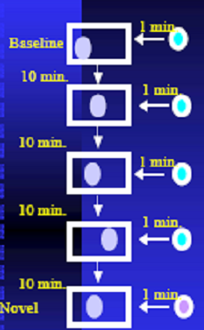
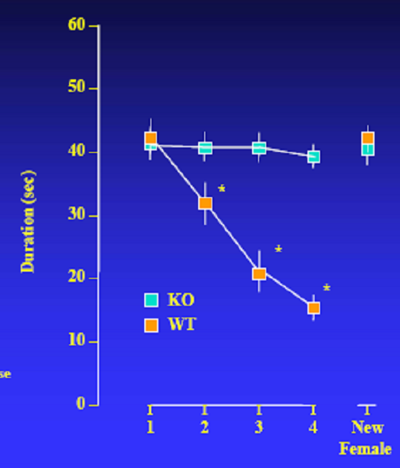
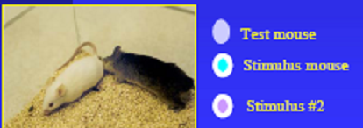
Knockout Oxytocin Mice: Social Cognition Deficits (Ferguson et al, Nature Genetics, 2001)
Notes:
15

Slide 16
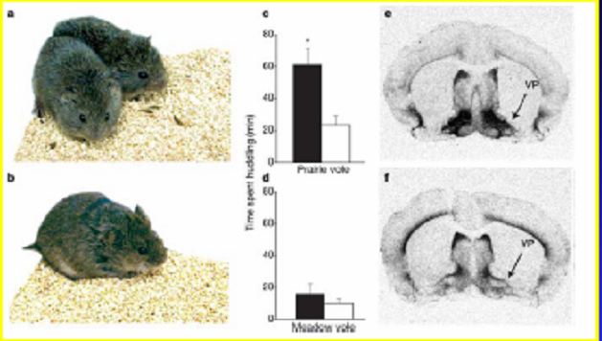
Vasopressin and Pair Bonds: Lessons from Prairie and Meadow voles (Lim et al , 2004)
Prairie voles: highly affiliative, show partner preferences after mating
Meadow voles: solitary, , do not say partner preferences
Differences in social behaviors may be linked to differential expression of V1aR
Notes:
16

Slide 17
OT System
Social information salience
DA reward
Conditioned partner preference
Social reinforcement learning
No developmental window
Rescue system at any stage of brain development

Slide 18
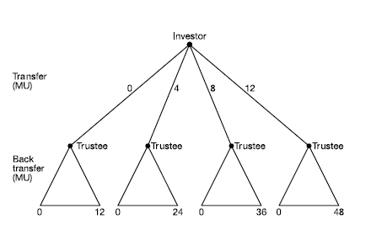
The Trust Game
Kosfeld et al , 2005
Notes:
18

Slide 19
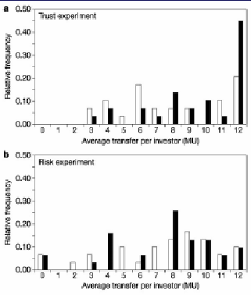
Oxytocin increases trust in healthy controls (Kosfeld et al, 2005)
Each observation represents average transfer amount over 4 transfer decisions per investor.
A. Relative frequency of investors’ average transfers in oxytocin (filled bars) and placebo ( open bars) ( n=58). Subjects on oxytocin transfer significantly higher amounts
B: Relative frequency of investors’ average transfers. Subjects in oxytocin and placebo groups show identical transfer levels.
Notes:
19

Slide 20
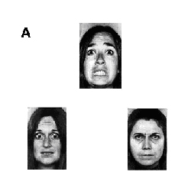
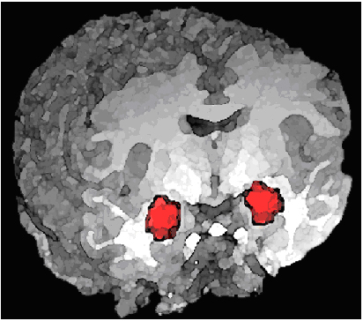
Emotion matching task illustrates effects of oxytocin on amygdala
(Source: NIMH Clinical Disorders Branch)
Participants were asked to select, from the two faces on the bottom, the one that expressed the same emotion as the face on the top.
Notes:
20

Slide 21
Oxytocin Selectively Improves Empathic Accuracy -dynamic, naturalistic task: individualized response
(Bartz, Hollander, et al. 2010)

Slide 22
Targets for Oxytocin in Autism
(from animal and healthy human studies)
Social Recognition
Social Affiliation
Social Threat
Amygdala and Fusiform activation
Eye Gaze
Social Memory
Trust
Social Anxiety

Slide 23

Effects of oxytocin vs. placebo infusions on
repetitive behaviors over time
Hollander et al, Neuropsychopharmacology, 2003
F=3.3, df=4,48, p=0.024

Slide 24

Oxytocin and Social Cognition
Affective Speech Recognition Measure
Hollander et al, Biol Psych, 2006
Sentences with neutral semantic content :
    “The boy went to the store.”
      “The game ended at 4 o’clock.”
    “Fish can jump out of the water.”
    “He tossed the bread to the pigeons.”
One of four emotional intonations (happy, indifferent, angry, and sad)
.

Slide 25
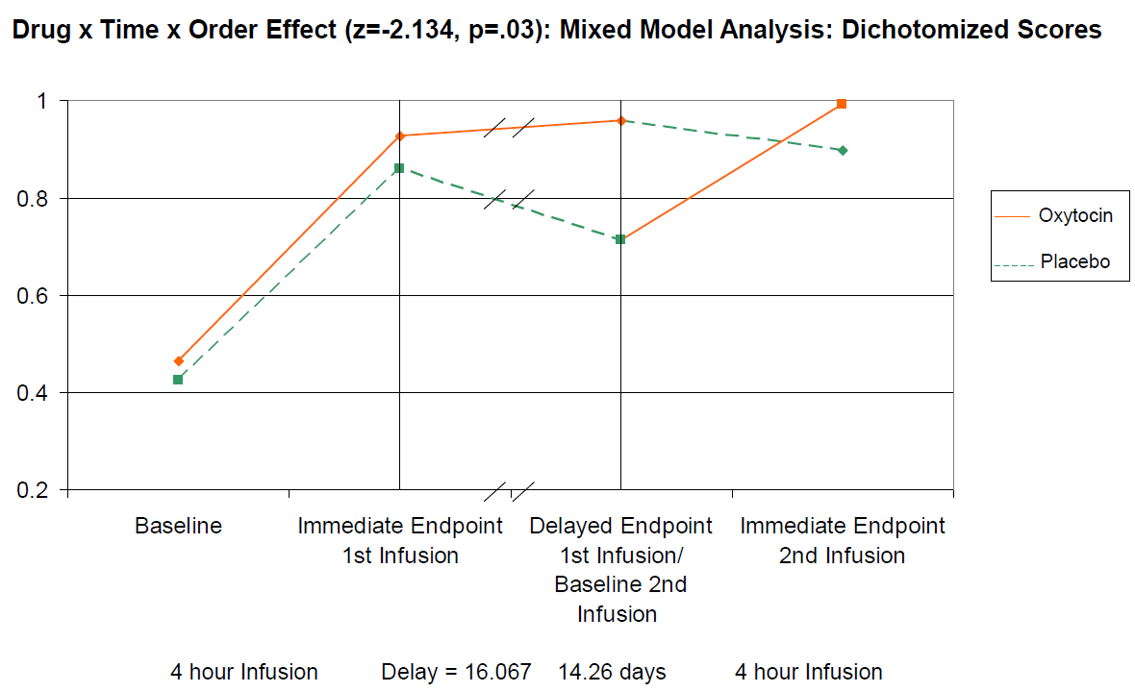
Oxytocin vs. Placebo: Comprehension of Affective Speech
Hollander et al, Biol Psych, 2006
Notes:
25

Slide 26
Intranasal Oxytocin Improves Emotion Recognition for Youth with Autism Spectrum Disorders (Guastella, et al. 2009)

Slide 27
Promoting social behavior with oxytocin in high-functioning autism spectrum disorders (Andari et al. 2010)

Slide 28
Promoting social behavior with oxytocin in high-functioning autism spectrum disorders (Andari et al. 2010)

Slide 29
Promoting social behavior with oxytocin in high-functioning autism spectrum disorders (Andari et al. 2010)

Slide 30
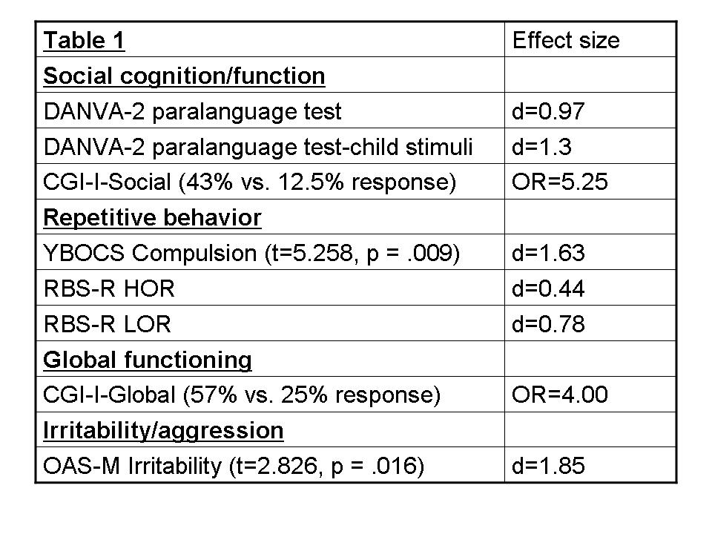
Effects of Chronic IN-OXT on core symptoms
IN-OXT vs. placebo (N=15) 24 IU BID for 6 weeks
Anagnostou and Hollander, Molec Autism, 2013

Slide 31
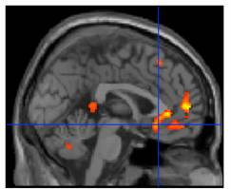
Brain activity during inhibitory control:
OT vs. placebo, Pre- vs. Post treatment
Aberrant activity in the subgenual and pregenual cingulate cortex was dampened following infusion of OT vs. placebo in individuals with ASD. Thus, greater activation was observed in this region pre-treatment than post-treatment when NoGo responses were required in patients receiving OT relative to those receiving placebo (t > 1.39, k=50 contiguous voxels).

Slide 32
Oxytocin and Social Cognition
Comprehension of affective speech
Hollander et al, Biol Psych, 2006
Comprehension of Affective Speech tested at baseline, 30, 60, 120, 180 and 240 minutes post-infusion
Four prerecorded sentenced with neutral semantic content were presented:
  “The boy went to the store”
  The game ended at 4 o’clock”
  “Fish can jump out of the water”
  “He tossed the bread to the pigeons”
Each sentence was presented twice with one of four emotional intonations (happy, indifferent, angry, sad)
Pairing of emotional expression and sentences in 1 of 6 counterbalanced orders

Slide 33
BP27801 POM Study
  Primary
  To explore the effects of a single dose of V1a(1) in adult high functioning autistic patients on biomarkers of core deficits of the disorder.
  To assess the safety and tolerability of a single dose of V1a(1) in adult high functioning autistic patients.
  Multi-centre (3 sites), randomized, double-blind, placebo-controlled, cross-over
  19 high-functioning adult autistic patients (IQ>70)
  Single i.v. dose, 2h hour administration
Period 1
Period 2
Scr
RO/
pbo
washout
pbo/ RO
Follow-up
Up to 4 wks
Day 1
Day 1
Single IV 2h infusion
Single IV 2h infusion
Optional inpatient O/N stay Day 1 in each period based on PI’s assessment

Slide 34
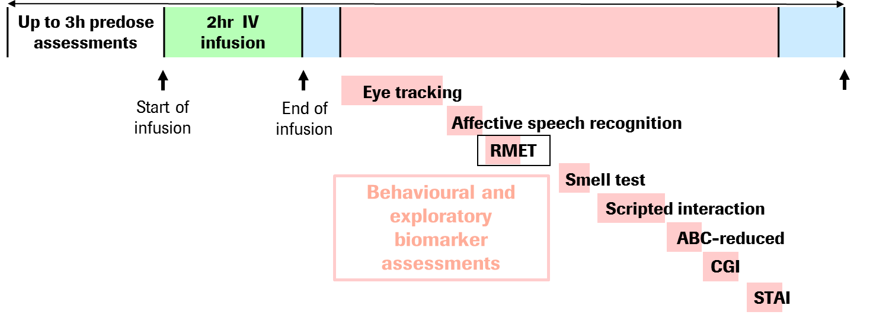
V1a Antagonist POM
Day 1 - Dosing Day Outline
Screening assessments:
-VABS,
-ADOS,
-ABC full scale
-IQ
Eye Tracking
Eye Tracking
ASR
Affective Speech Recognition
RMET
Smell Test
Scripted Interaction
ABC reduced
CGI
STAI
STAI

Slide 35
Eye-tracking programs
Based on Klin et al. (2002)
Biological Motion Preference: Preference for biological motion over scrambled human or mechanical motion (Pelphrey et al 2002)
Biological Detection: Detection of biological motion (Kaiser et al 2010).
Human Activity: Preference for dynamic human activities over geometric patterns (Pierce et al 2011)
Static Face Scanning (Gender and Gaze Discrimination): Face scanning during a cognitive discrimination of gender and gaze direction (Klin et al 2009)
Complex Social: Patterns of scanning during free-viewing of complex social scenes (Klon et al 2002)

Slide 36
Total composite score

Slide 37
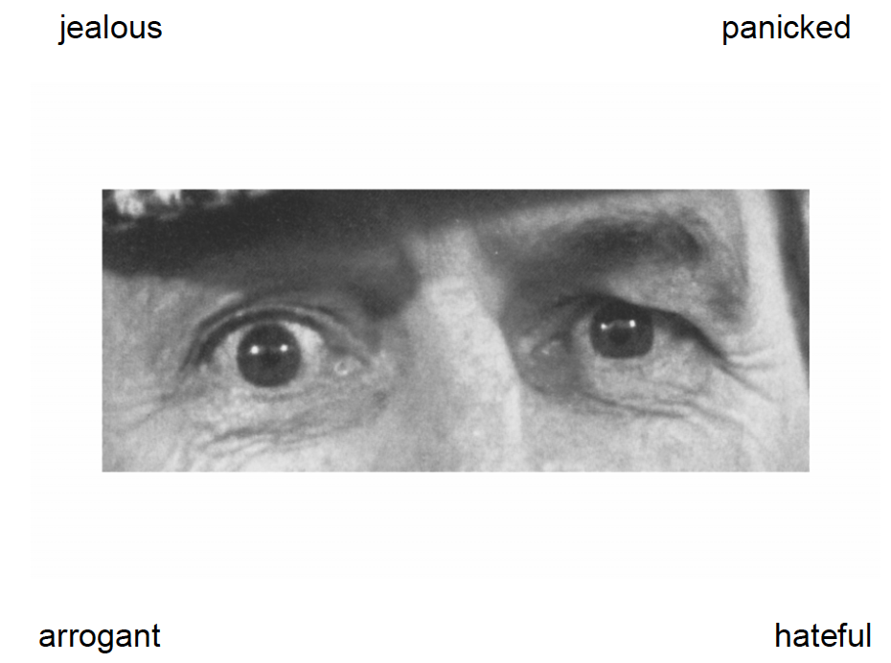
PD readouts
Reading the Mind in the Eyes Test (RMET)
36 pictures of the eye regions of different people.
4 alternative labels to choose what best describes the person’s thoughts or feelings
Scores 0 (incorrect) and 1(correct)

Slide 38
Reading the Mind in the Eyes Test (RMET)
% Correct answers | Mean Placebo | Mean RO | ES
 | 60.702 | 64.303 | 0.2

Slide 39

Affective Speech Recognition Task (ASR)
Designed to measure comprehension of affective speech (empathic accuracy)
  6 neutral sentences
    Example: “The boy went to the store
  8 different emotions
    Lust, fear, happy, sad, angry, neutral, surprise,, and disgust
  Listen to the pre-recorded sentences,
  circle the emotion they think the reader is expressing

Slide 40
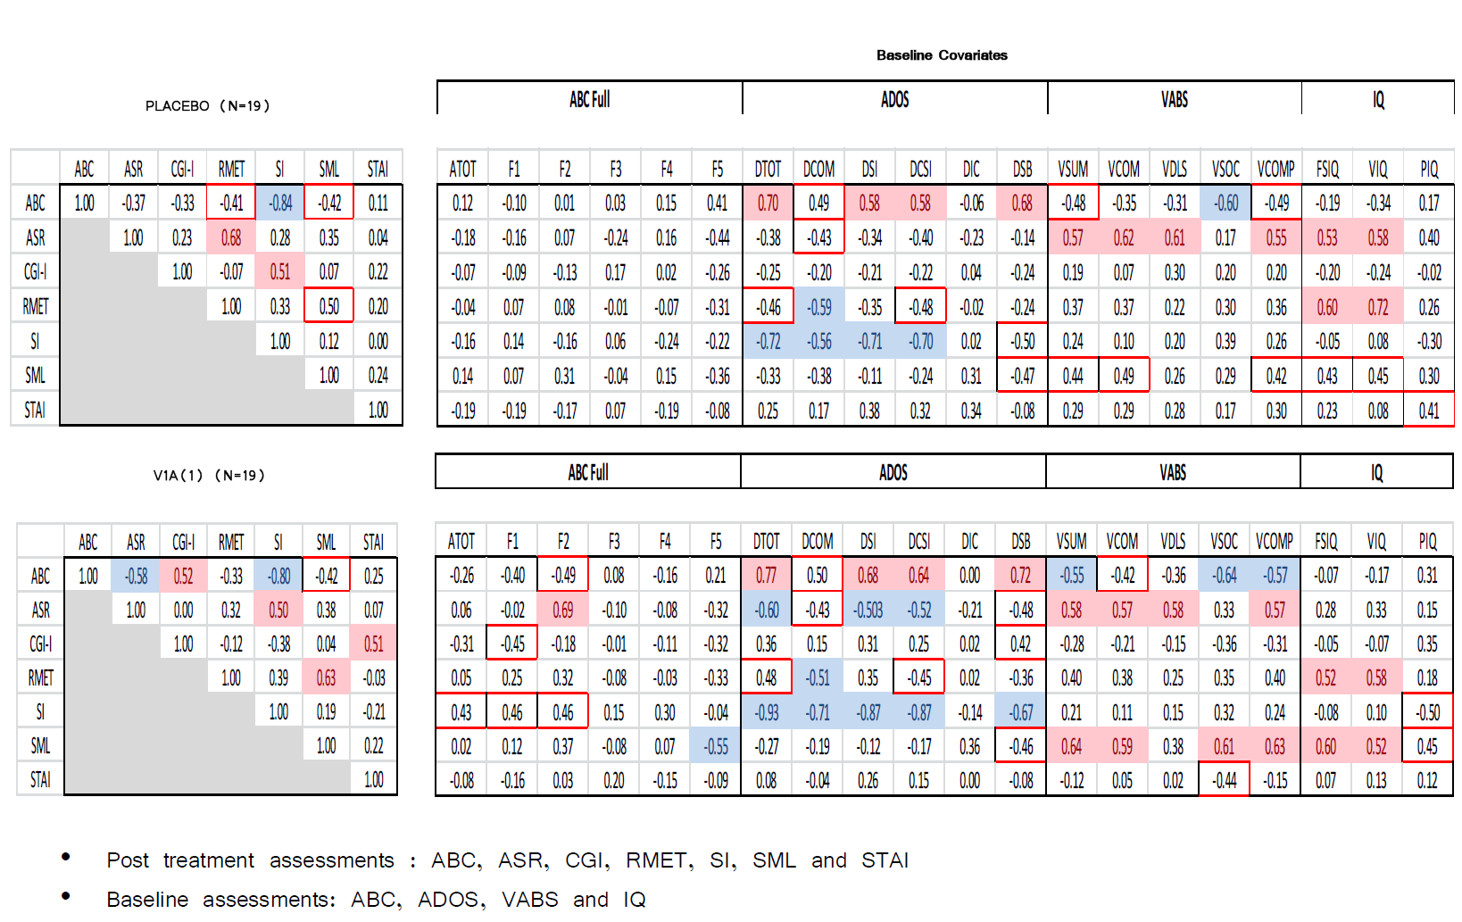
Correlation analysis

Slide 41
Affective Speech Recognition (ASR)
 | LSMean RO | LSMean Placebo | Estimate RO-Pbo | 90% CI Lower | 90% CI Upper | p-value | ES
% Angry | 52.897 | 51.653 | 1.244 | -14.017 | 16.506 | 0.885 | 0.0
% Disgust | 65.390 | 65.261 | 0.129 | -12.370 | 12.628 | 0.986 | 0.0
% Fearful | 55.823 | 75.466 | -19.643 | -36.921 | -2.365 | 0.066 | -0.7
% Happy | 65.845 | 61.568 | 4.277 | -8.736 | 17.290 | 0.572 | 0.2
% Lust | 41.166 | 64.455 | -23.289 | -39.044 | -7.534 | 0.025 | -0.8
%Negative emotions | 212.695 | 221.435 | -8.740 | -45.823 | 28.343 | 0.684 | -0.1
% Neutral | 67.102 | 65.916 | 1.186 | -9.178 | 11.551 | 0.844 | 0.0
%Positive emotions | 155.608 | 169.835 | -14.228 | -42.759 | 14.304 | 0.395 | -0.2
% Sad | 61.807 | 60.456 | 1.351 | -16.432 | 19.135 | 0.893 | 0.0
% Surprise | 69.697 | 64.727 | 4.970 | -6.105 | 16.044 | 0.442 | 0.2
% Correct answers | 53.893 | 56.589 | -2.696 | -11.330 | 5.938 | 0.591 | -0.1

Slide 42
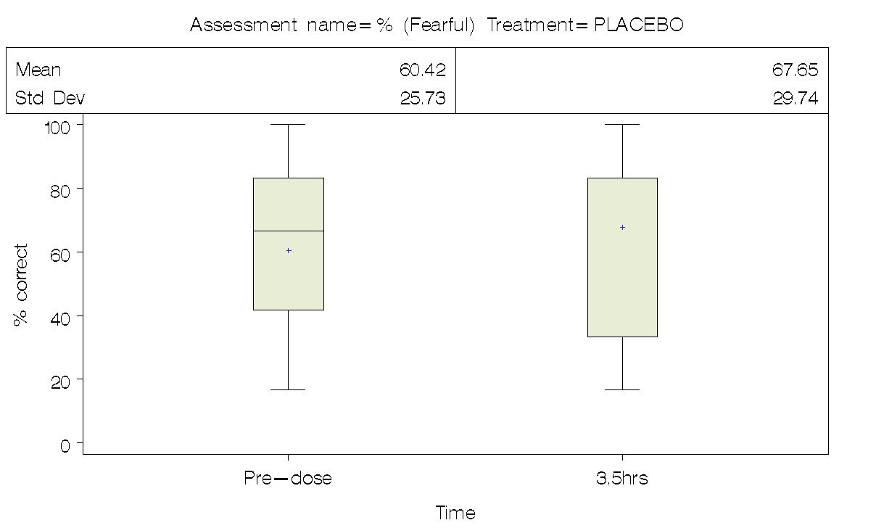
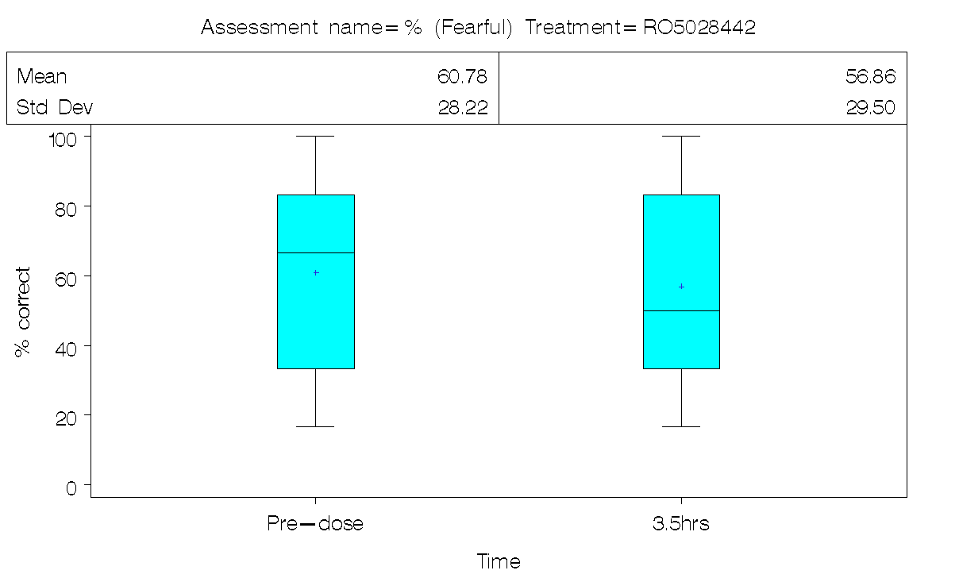
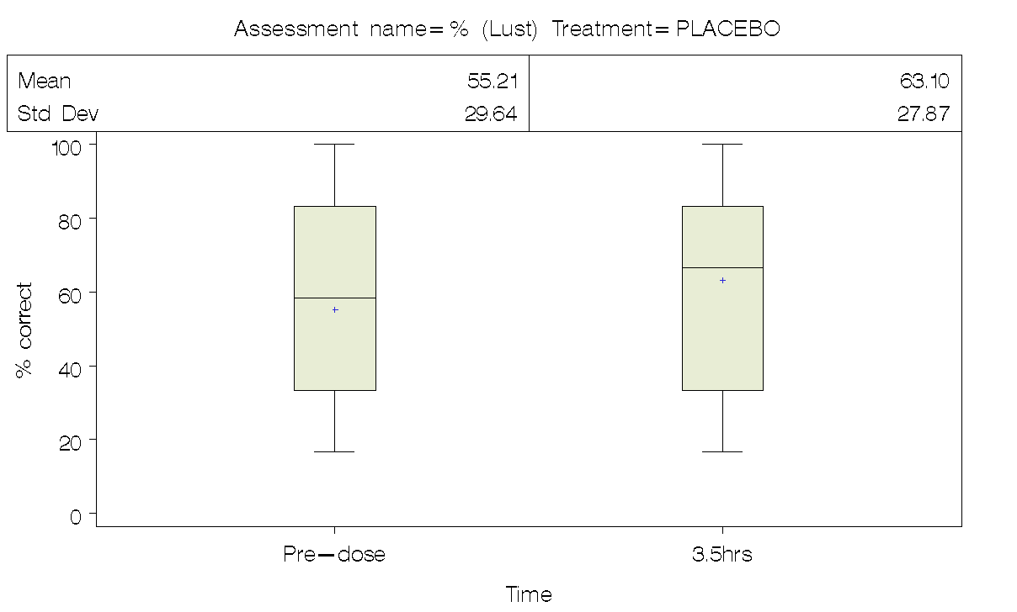
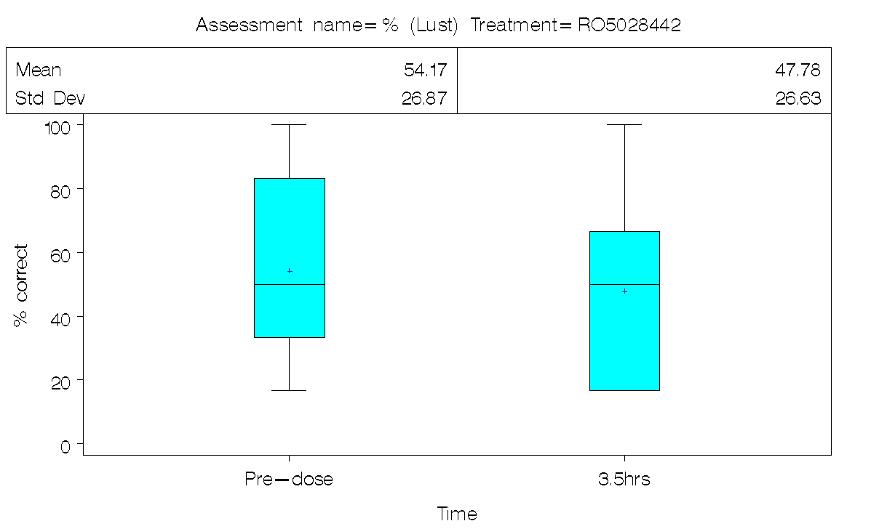
Affective Speech Recognition Task

Slide 43
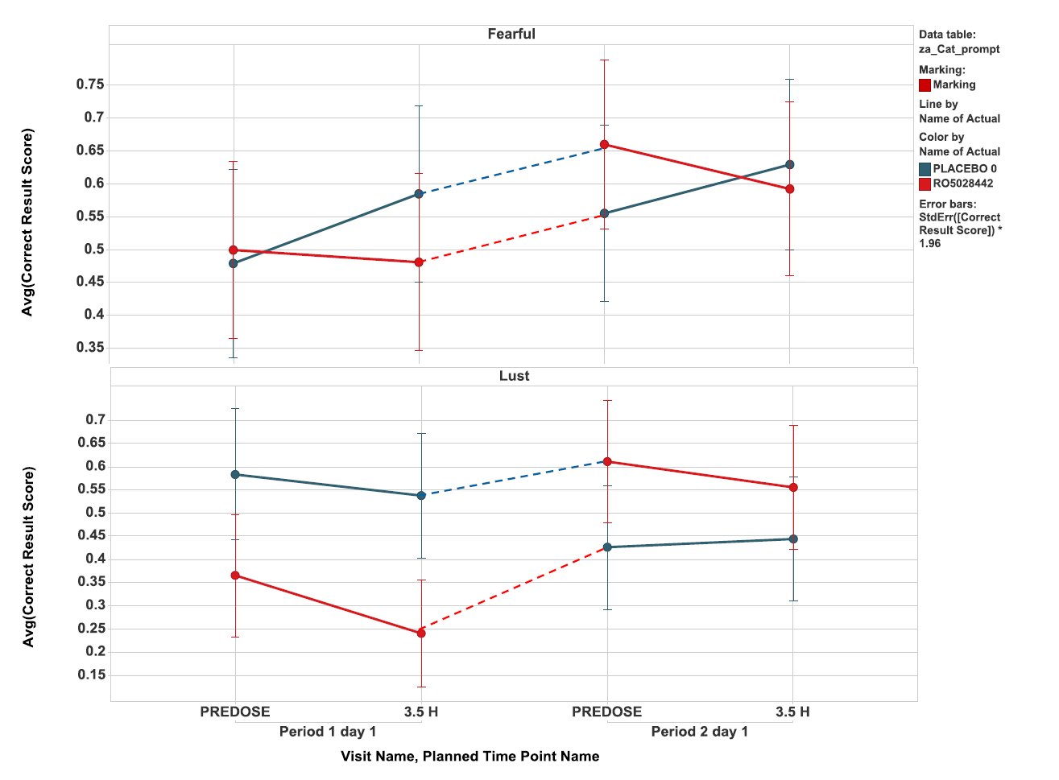
Affective Speech Recognition (ASR)
Learning Effect

Slide 44
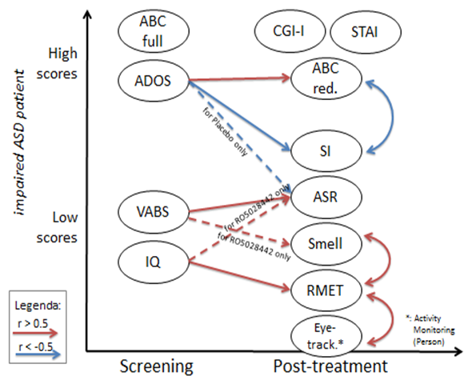
ASR influenced by V1a, Smell, Adaptive Function

Slide 45
Prader-Willi Syndrome (FPWR) Study
8 week IN-OXT (16 iu BID) vs placebo
24 children and adolescents (5-18 years of age)
PWS and ASD features
Outcomes:
1. Primary: Hyperphagia (Eating) Measures
  Binge Days/Week, PWS Hyperphagia Questionaire, BMI
2. Secondary: Repetitive, Disruptive, Social cognition
  RBS-R, CYBOCS, ABC-I, ABC-SW, SRS, ASR
3. Tertiary: Salivary OT levels, plasma ghrelin, leptin, pancreatic polypeptide, OTR genotype
4. Other – grip (hypotonia), global (CGI), QOL

Slide 46
Tuberous Sclerosis Complex
(TSC)
Rare Disease (1 in 6,000 births)
Neurodevelopmental and Neurocutaneous Disorder
  de novo mutation or autosomal dominant inheritance, mutations in TSC1 or TSC2 genes.
  dysregulation of mTOR signaling
  hamartomas multiple organ systems
  epilepsy, neurocognitive dysfunction, mental retardation and ASD
Notes:
46

Slide 47
TSC and ASD
Co-morbid ASD in 63% of TSC patients
Similar neurocognitive deficits and epilepsy
More cyst-like tubers, more in temporal and occipital lobe - in those with TSC and co-morbid ASD
More mutations TSC2 gene with neurological disease
TSC2 mutations in those with ASD in absence of TSC phenotype

Slide 48
Tuberous Sclerosis Complex
(TSC): Mechanism
Inactivating mutations of TSC1 and TSC2 genes cause hyperactivation of the mTOR pathway
Typically TSC1-encoded protein hamartin binds to TSC2-encoded protein tuberin to form heterodimer complex
  Regulates mTOR pathway responsible for protein synthesis, cell proliferation and oncogenic proliferation
Mutations prevent heterodimerization
Sets up cascade that increase cell proliferation and interferes with normal signaling
Upstream routes converge on TSC1:TSC2 protein complex to regulate mTOR signaling:
  IGF-1, PI3Kinase, PDK1 and Akt
mTOR mediates phosphorylation of key proteins downstream
  4E-BP-1, S6kinase and S6
Proteins affect regulation of cell growth and function via transcription, translation, metabolism, ribosomal biogenesis, dendriteogenesis and spine formation

Slide 49
Tuberous Sclerosis Complex
(TSC): Figure
Figure 1: OXT Mechanism via PI3K/Akt/ mTOR Pathway

Slide 50
Tuberous Sclerosis Complex
(TSC): Oxytocin
Signaling cascades work in tandem with mTOR cascade
Take advantage of points of intersection with other systems to control dysregulation in the pathway
OXT acts further upstream
  Treatment for disruptive and repetitive behaviors and improvement of social cognition deficits
Regulation of mTOR pathway through phosphorylation of PLCδ and attenuation of the PI3K/AKT signaling pathway
  Through inhibition of cell proliferation dependent on Gi coupled protein signaling
Increase phosphorylation of Raptor while downregulating abundance and phosphorylation of S6K1 and 4E-BP1
Treatment that restores balance to the signaling pathways disrupted in TSC

Slide 51
Tuberous Sclerosis Complex
(TSC): Proposed Study
8 week trial of intranasal oxytocin vs placebo
50 children with TSC and co-morbid ASD features
Primary Outcome:
  ABC-SW

Slide 52
Repetitive Behaviors
YBOCS Subfactors
washing
contamination
1.0
1.0
1.10
checking
aggression
1.26
Factor 1
Factor 2
.18
.75
repeating
sexual
1.42
.45
ordering
1.36
.78
religious
.85
.62
rituals involving
others
magical
.39
.66
1.45
ritualized
eating
.44
somatic
damaging
.75
Hoarding
obsessions
.94
Factor 4
Factor 3
-.14
1.0
1.0
rubbing
Hoarding
compulsions
.96
superstitious
games

Slide 53
Cytokines affect multiple pathways
Monoamine metabolism
Neuroendocrine function
Synaptic plasticity
Neurocircuitry

Slide 54
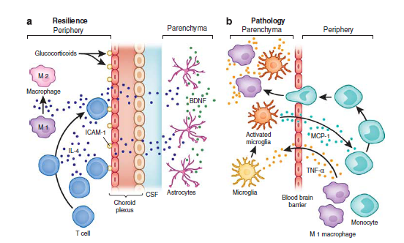
Pro-Inflammatory Cytokines Activate Microglia
(Haroon et al. Neuropsychopharmacology, 201; 37: 137–162)

Slide 55
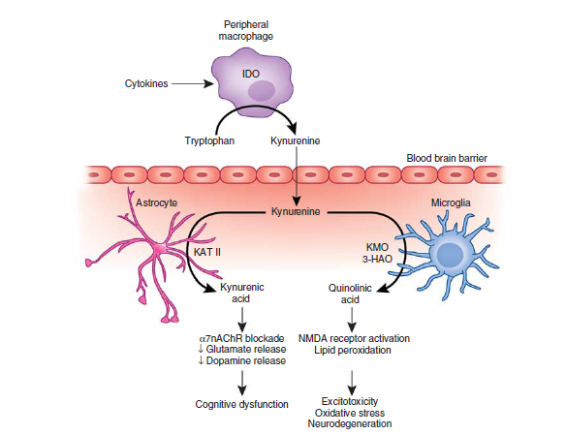
Translational Implications of the Impact of Inflammation on Behavior
(Haroon et al. Neuropsychopharmacology, 201; 37: 137–162.)

Slide 56
Microbiome
More cells in our body are not us than are us
90% of our DNA is microbial, not human.
“We” are, in fact, “super-organisms” made up of thousands of species.
Microbiomics important for immune-inflammatory illness and autism

Slide 57
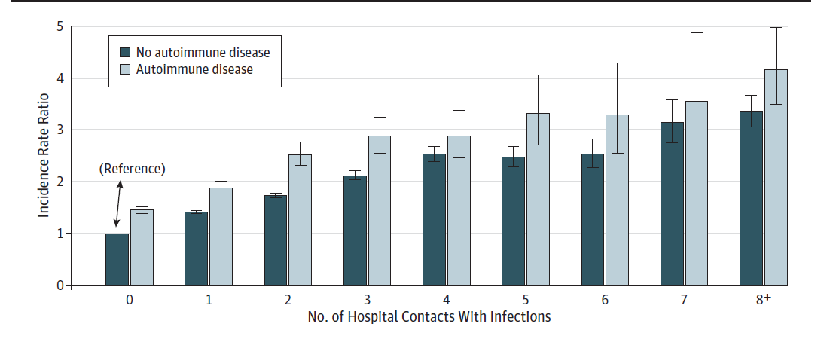
From: Autoimmune Diseases and Severe Infections as Risk Factors for Mood Disorders: A Nationwide Study
JAMA Psychiatry. 2013;():1-9. doi:10.1001/jamapsychiatry.2013.1111

Slide 58
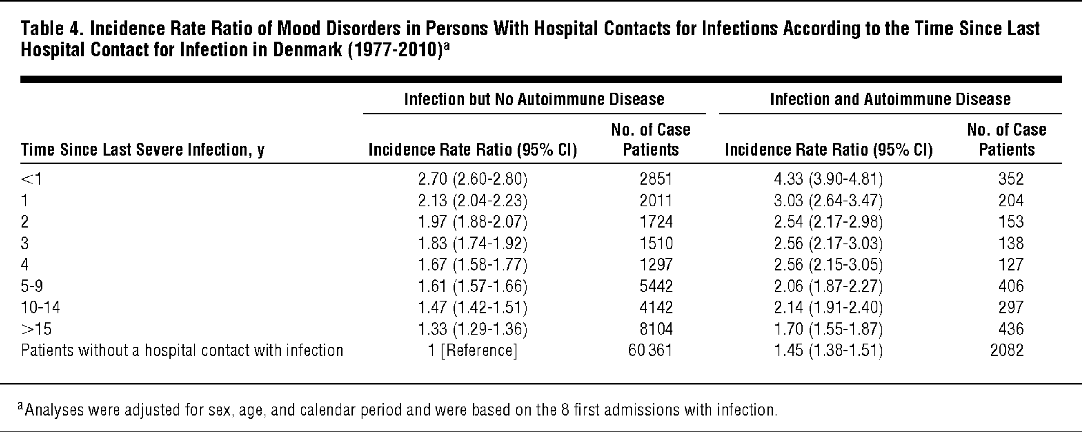
From: Autoimmune Diseases and Severe Infections as Risk Factors for Mood Disorders: A Nationwide Study
JAMA Psychiatry. 2013;():1-9. doi:10.1001/jamapsychiatry.2013.1111

Slide 59
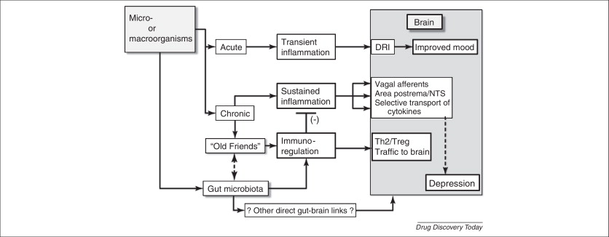
Drug Discovery Today
Volume 17, Issues 9-10, May 2012, Pages 451-458. 10.1016/j.bbr.2011.03.031
Date of download: 6/25/2013

Slide 60
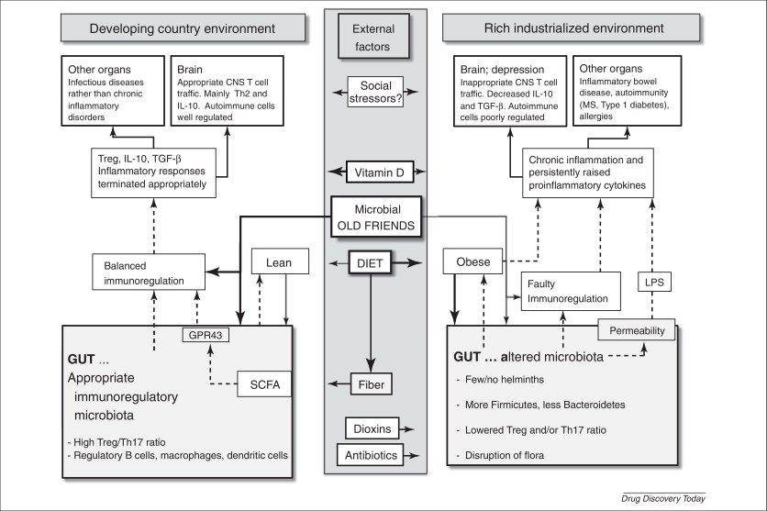
Drug Discovery Today
Volume 17, Issues 9-10, May 2012, Pages 451-458. 10.1016/j.bbr.2011.03.031
Date of download: 6/25/2013

Slide 61
Febrile Hypothesis
Improvement in 1/3 ASD subjects with fever
Three mechanisms
  1. Direct effect of temperature
    Hot tub (102°F vs. 98°F)
    thermolabile –HMC/ MeC gene expression
  2. Normalize dysregulated LC-NA
    maternal stress and cortisol
    Milnacipran vs placebo
  3. Immune-inflammatory response
    TSO helminths vs placebo

Slide 62
Febrile Response in Autism – Clinical Improvement After Fever: ABC scores-irritable, withdrawal, hyperactive, stereotypy, inappr. speech
(Curran et al. Behaviors associated with fever in children with ASD. Pediatrics, 2007;120:e1386-e1392)

Slide 63
Hyperthermia and Autism Symptoms
Study Design
  Children with ASD - 5 to 17 years
  HydroWorx Therapy Pool to increase body temperatures
  Stage One: ASD Control Subjects
    5 ASD children with no history of febrile response
    Safety and feasibility of increased temperature to 102°F
  Stage Two: 10 ASD Subjects with history of febrile response
    Double blind crossover study in 10 children
    Pool Temperatures of 98° and 102°F
  Outcome measures include:
    Buccal swab collection (epigenetic data: HMC)
    Pupillometry
    Social Cognition, Repetitive/Restrictive Behaviors, Global Improvement, Vital Signs, Temperature Max

Slide 64
Hyperthermia and Autism Symptoms:
Demographic Data
10 ASD Subjects with Febrile Response History
  7 males, 3 females
  Mean IQ: 60.4
  Mean Age: 8.9 years (Range 5 to 17)
  Ethnicity:
    4 Caucasian
    3 African -American
    2 Hispanic
    1 African-American/Hispanic

Slide 65
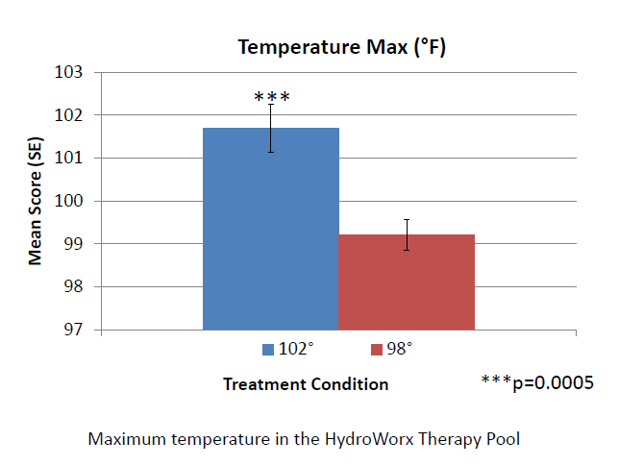
Maximum temperature in HydroWorx Pool

Slide 66
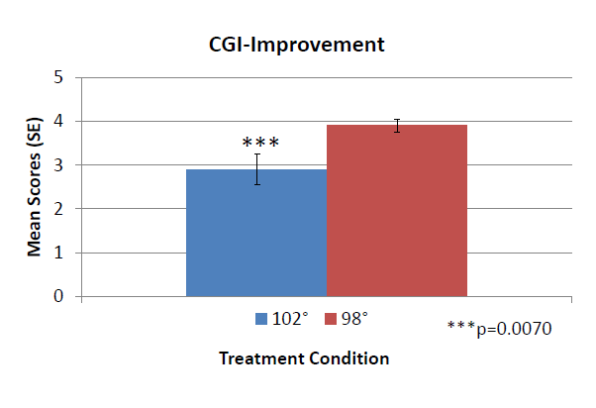
*

Slide 67
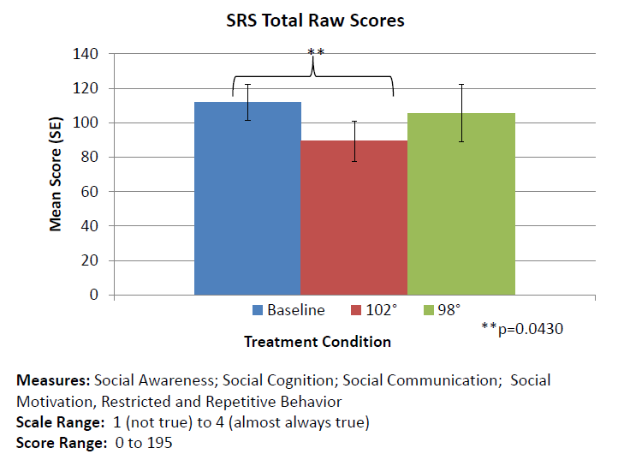

Slide 68
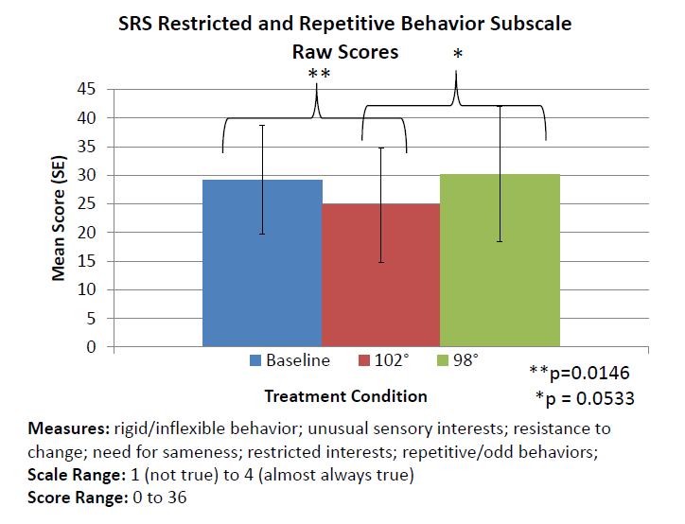

Slide 69
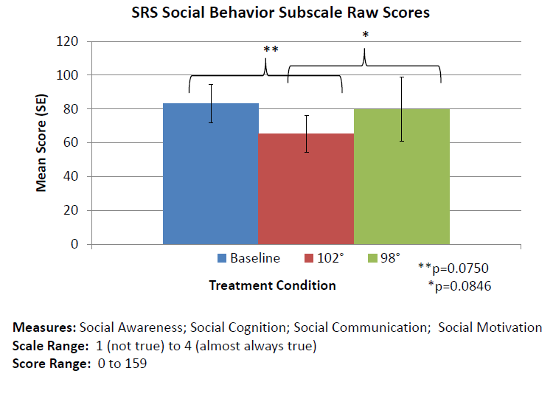

Slide 70
Hyperthermia and Autism
  Improvement on CGI-I
  Improvement on SRS-repetitive behavior
  Gene expression and biomarker measures will examine mechanism of febrile response

Slide 71
Parental Autoimmune Diseases Associated with Autism Spectrum Disorders in Offspring
Keil et al. Epidemiology, 2010;21(6):805-808

Slide 72
Immune Dysfunction in Autism:
A Pathway to Treatment
Careaga et al. Neurotherapeutics, 2010;7:283-292

Slide 73
Abnormal behavior in MIA offspring is prevented by maternal treatment with anti-IL antibody
(Smith et al. Maternal Immune Activation Alters Fetal Brain Development through Interleukin-6. Neurobiology of Disease, 2007;27(40):10695-10702.)

Slide 74
Immune Dysfunction in Autism:
A Pathway to Treatment
Careaga et al. Neurotherapeutics, 2010;7:283-292

Slide 75
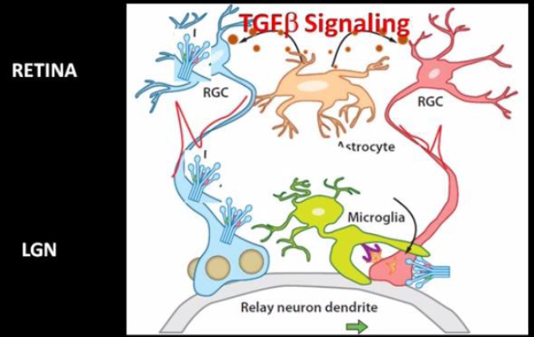
Microglia involved in Synaptic Pruning
Complement and Cytokine Label of neurons to be pruned by microglia
Beth Stevens, 2013

Slide 76
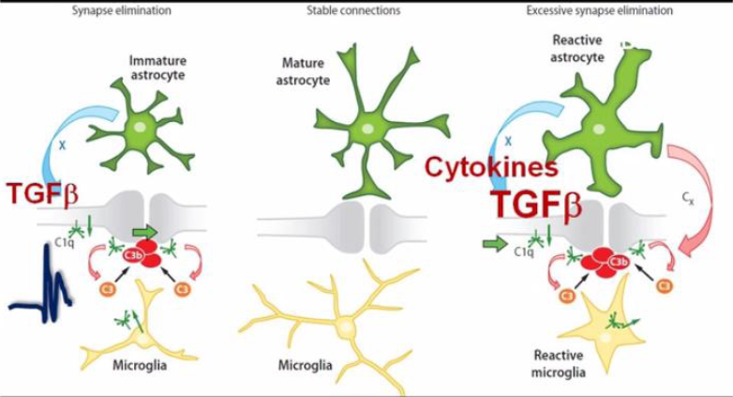
Excess Synapse Elimination in Autism and Developmental Disorders

Slide 77
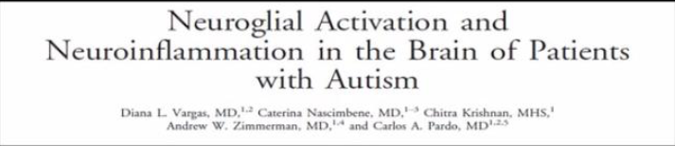
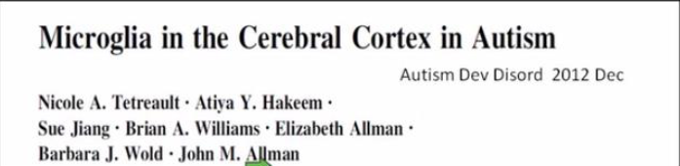
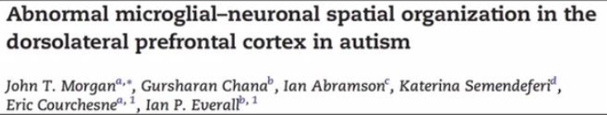

Slide 78
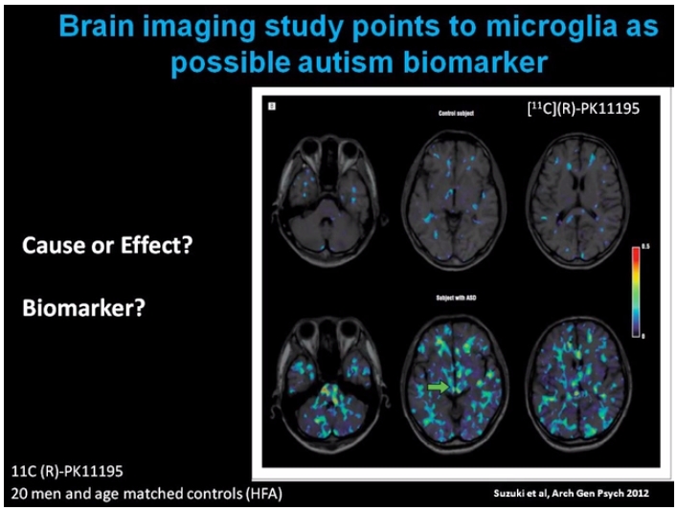

Slide 79
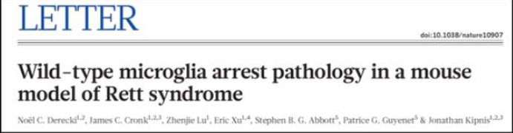
Microglia Dysfunction in Rett Syndrome
Irradiation of Peripheral Immune System
Replacement with Healthy T cells

Slide 80
Immune Dysfunction in ASD
Hygiene hypothesis –
  asthma, autoimmune, ASD
  Lack of favorable gut parasites
Increased pro-inflammatory cytokines
  CSF, postmortem tissue
Microglia activation
  postmortem tissue
Notes:
80

Slide 81
Trichuris Suis Ova in Autism Spectrum Disorders (TSO):
Study Design
10 HFA adults, aged 18 to 35 years
Double-blind, randomized, crossover trial
  12 weeks of TSO treatment
  12 weeks of placebo
  4 week washout period in between

Slide 82
Trichuris Suis Ova in Autism Spectrum Disorders (TSO):
Study Design
10 subjects, aged 18 to 35 years
9 subjects complete data, 1 early drop out
5 subjects interim analysis – rigidity/sameness
Double-blind, randomized, crossover trial
  12 weeks of TSO treatment
  12 weeks of placebo
  4 week washout period in between

Slide 83
Statistical Methods
Crossover design analysis (as well as review of carryover effects) to measure differences from Week 0 to Week 12 for each period/treatment sequence.
  Using a mixed model with fixed effects for sequence, period, treatment, and a random effect for sequence within patient.
  This allowed determination of whether there was a significant difference between the changes to each Week 12 between the treatment conditions (TSO and PBO)
  This is the primary p-value assessment for the crossover component of the study
Week 0 (for Period 1) and Week 16 (for Period 2) were used as ‘baseline’ for each respective period
Week 12 LSMean values (+/- Standard Error) bar charts are presented
  Where Week 12 p-values were < 0.20, they are presented on the plot

Slide 84
Statistical Methods:
Secondary Analysis: Longitudinal
For each outcome, a longitudinal mixed model was run, using all available data (no imputation for missing values was performed).
  Data were analyzed as a ‘parallel’ design, even though the data were collected in a crossover fashion.
  For Period 1 (Weeks 0 to 12), time points were Weeks 0 (baseline), 2, 4, 6, 8, 10, and 12
  For Period 2 (Weeks 16 to 28), time points were assigned as: Week 16 = Week 0 (baseline), Week 18 = Week 2, Week 20 = Week 4, etc., and Week 28 = Week 12.
The model included effects for treatment, time, the treatment by time interaction, and the baseline value as a covariate.
Mean and standard error (SE) were determined for each treatment at each protocol-scheduled time point
P-values are only presented for Week 12, and only where they were marginally significant (p<0.10).

Slide 85
Secondary Methods
A check of treatment effect (at Week 12) and carryover effect (as part of the analysis of the data under the crossover study design) was performed using a mixed model with fixed effects for sequence, period, treatment, and a random effect for sequence within patient.
This model accounted for the crossover nature of the study design
Results: A few variables had marginally statistically significant evidence of carryover, but the vast majority showed no evidence of carryover.

Slide 86
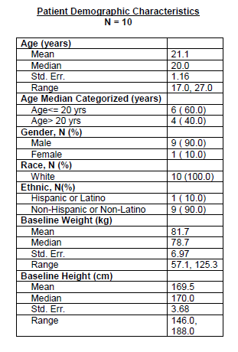
Patient Demographics

Slide 87
Interim TSO vs Placebo in ASD
First 5 ASD subjects
Meaningful impact on rigidity and sameness on three measures
Needed to be replicated in second 5 subjects
Need to study younger ASD subjects with higher baseline irritability

Slide 88
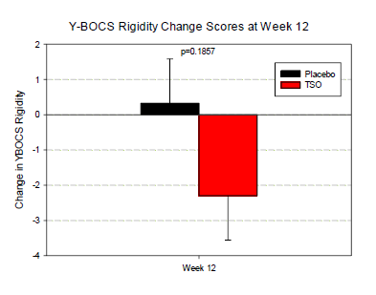
Y-BOCS Rigidity
Cohen’s d = 0.79

Slide 89
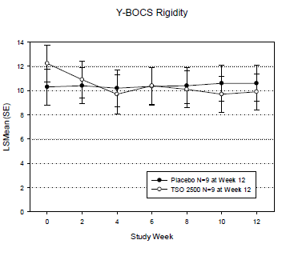
Y-BOCS Rigidity
Cohen’s d = 0.79

Slide 90
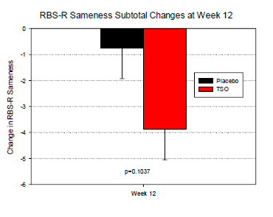
RBS-R Sameness Behavior
Cohen’s d =1.0

Slide 91
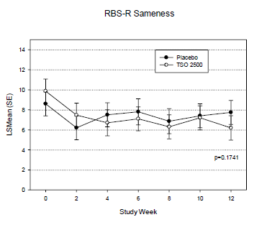
RBS-R Sameness Behavior
Cohen’s d = 1.0

Slide 92
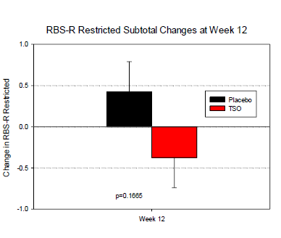
RBS-R Restricted Behavior
Cohen’s d = 0.82

Slide 93
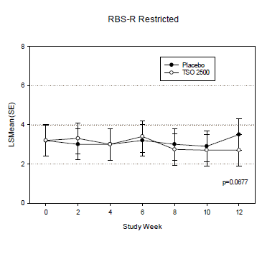
RBS-R Restricted Behavior
Cohen’s d = 0.82

Slide 94
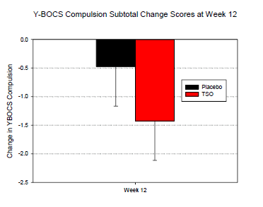
Y-BOCS Compulsion
Cohen’s d = 0.52

Slide 95
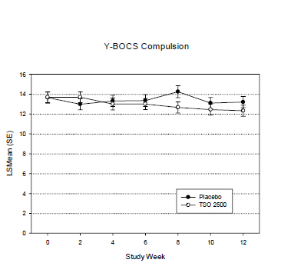
Y-BOCS Compulsion
Cohen’s d = 0.52

Slide 96

SRS Repetitive Behaviors
Cohen’s d = 0.45

Slide 97
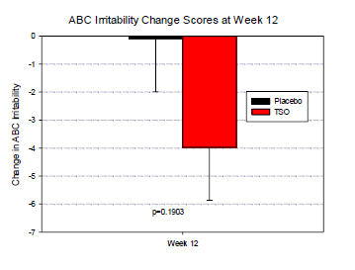
ABC Irritability
Cohen’s d = 0.78

Slide 98
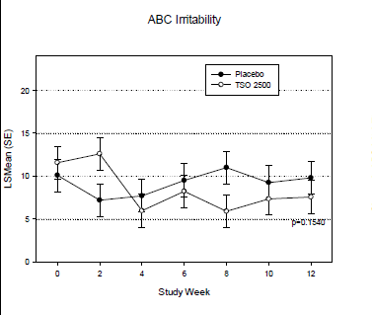
ABC Irritability
Cohen’s d = 0.78

Slide 99

SRS Social Behaviors Subscale

Slide 100

ABC Lethargy/Social Withdrawal

Slide 101

ABC Inappropriate Speech

Slide 102

ABC Hyperactivity

Slide 103


Slide 104

Summary of Efficacy Outcomes

Slide 105
TSO for Adult HF ASD
Rigidity, Craving for Sameness, Restricted Behaviors
  Large effect sizes – Cohen’s d = .79, d= 1.0, d= .81
    Effect size of 0.8 allows 80% power to detect two sided Type I error rate of 5% for a sample size of N= 25 vs. 25 .
Well tolerated – no SAE, no discontinuation due to AE
Studies needed in pediatric ASD with irritability
Stratification – Immune dysfunction
Early efficacy biomarkers – PET ligand microglia, proinflammatory cytokines
Novel drug development for homogeneous populations

Slide 106
Demographics: Completed Patients
Patient | Gender | Age | Race & Ethnicity | Fit for Study
TSO-01: OM | Male | 21 | White Non-Hispanic | Personal history of seasonal allergies Family history of autoimmune dysfunction
TSO-02: AS | Male | 19 | White Non-Hispanic | Family history of seasonal allergies
TSO-04: KP | Male | 20 | White Non-Hispanic | Family history of seasonal allergies Personal history of asthma and febrile responses
TSO-05: DL | Male | 19 | White Non-Hispanic | Allergies to wheat, eggs, dust, and dogs Childhood asthma Less perseverative and figidity when sick
TSO-06: AM | Male | 24 | White Non- Hispanic | Allergies to PCN and Antihistamines History of seasonal allergies in Spring

Slide 108

Montefiore-Einstein Rigidity Subtotal
Week 12 treatment effect difference was 2.53 in favor of TSO.
Notes:
Outcome: Week 12 treatment effect difference was 2.53 in favor of TSO.

Slide 109

RBS-R Sameness Subtotal
Week 12 treatment effect difference was 3.91 in favor of TSO.
Notes:
Outcome: Week 12 treatment effect difference was 3.91 in favor of TSO.

Slide 110

SRS Repetitive Behavior Subscale Subtotal
Week 12 treatment effect difference was 6.49 in favor of TSO.
Notes:
Outcome: Week 12 treatment effect difference was 6.49 in favor of TSO.

Slide 111

ABC Irritability Subtotal
Week 12 treatment effect difference was 3.20 in favor of TSO.
Notes:
Outcome: Week 12 treatment effect difference was 3.20 in favor of TSO.

Slide 112
TSO vs Placebo in ASD-Interim
Significant impact - rigidity and sameness
Well tolerated
Needs to be replicated
Need to study younger ASD subjects with higher baseline irritability

Slide 113
Genetics of ASD –
Drug Development
Estimates of 100 genes - small effect size –
Heterogeneity of molecular mechanism
  Decreases drug vs placebo signal
  Need to stratify population
CNV’s - microdeletions/duplications – not causal
Syndromal autism (Fragile-X, Rett’s, PWS, TSC)
  More homogeneous pathway for drug development
Gene x Environment Interaction
  Glial/Immune hub pathway genes
  Maternal immune activation
  Hygiene hypothesis

Slide 114

Molecular Pathogenic Alterations of
Glial and Immune Related Genes/Protein Networks
In Autism
Voineagu et al Nature 2011

Slide 115

Correlation of right caudate volume (mm³) with higher order repetitive behaviors (r=0.600, p=0.039)
Hollander, Anagnostou et al, Biol Psychiatry, 2005
Notes:
115

Slide 116
Drug Development for Repetitive Behavior and Social Cognition Domains of ASD
Heterogeneity: need to stratify
  Symptom domains
  Biomarkers
  Rare Homogeneous Syndromal Forms of ASD
Match compound to underlying molecular mechanism
Outcome Measures –
  early efficacy biomarkers
  more proximal to underlying mechanism
OT/V1a – social cognition and hyperphagia
Glial/Immune – repetitive behavior domain

